Slide 1
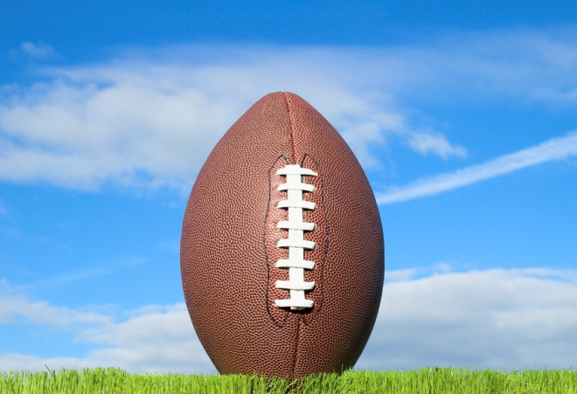
Football Economics:
The Market for the Game
Supply and Demand Basics
A market is a series of individual exchanges conducted by pairs of consenting parties for a defined product or service over a specific period of time.
For example, the annual market for Super Bowl tickets involves a variety of agents with permission to sell specified tickets seeking buyers who wish to attend the game.
The buying side of the market is called demand; the selling side of the market is called supply.
In professional football, owners sell entertainment (supply) and spectators buy the opportunity to view or display the game (demand).
Meanwhile, owners also buy the services of athletes who wish to play (demand) and trained athletes make themselves available for a price (supply).
If owners and players don’t come to an agreement, nothing forces them to do so. This is the free market element of professional football. We neither conscript individuals to play the game nor do we force an owner to continue operating the team if she no longer desires to do so. She is free to sell the team or simply close it down. And, the players are free to seek alternative employment. Both of these market exits happen quite often in the NFL.

Slide 2
Football Economics:
The Market for the Game
What do the owners supply?
Owners sell access to view a football contest. Over time, this has evolved to be a fully inclusive product covering small, dramatic elements of the player, coaches, and owner’s lives as well history and statistics related to the game.
Owners ration scarce supply for in-person viewing by charging for seats in the stadium.
Owners ration access to television viewing by selling some broadcast rights to the highest bidder. The broadcast company with rights then sells advertising opportunities.
Owners make online and cable television viewing available by selling scarce advertising opportunities on cable and web-based venues.

Slide 3
Football Economics:
The Market for the Game
What do the buyers demand?
Some spectators demand a live event to enjoy or utilize for entertainment purposes.
Some networks demand broadcast television rights to sell commercial time.
Some merchandisers demand cable or online commercial time to increase their product sales.

Slide 4
Football Economics:
The Market for the Game
What does athlete supply?
Athletes are the key labor resource for professional football.
Athletes seek a financial payoff for 1 - 12 years of unpaid training and practice time.
Athletes seek high wages to justify the physical difficulty and long-term injury risk of playing football.
Athletes seek long-term retirement care due to the hazardous nature of the game.
Some athletes respond to non-financial incentives such as billboards and other advertising with their image.
Athletes supply the essential input to the owner’s entertainment product and these lead them to work cooperatively through a union to increase their negotiating power.

Slide 5
Football Economics:
The Market for the Game
What does the owner demand?
Owners seek to purchase labor services from athletes.
Owner’s labor demand includes:
Stars to market
Good players to enhance competitiveness
Filler players to practice against or provide injury replacements
Owners perceive value based on number of plays on the field, number of plays with direct impact on the result of the play, win shares over replacement value, and popularity with the fan base.
Owners compensate athletes with upfront signing bonuses, regular pay, deferred pay, performance bonuses, training opportunities, and promotions.

Slide 6
Football Economics:
The Market for the Game
The Law of Demand
Football-related products follow the same law of demand as all other goods.
Law of Demand:
As the price of a good rises, the quantity demanded for the good falls, and as the price falls, quantity demanded rises, all other things being equal (ceteris paribus).
Lower costs goods are used as substitutes
Marginal Utility declines as the amount of the good increases
P Q and P Q
Definition from Arnold, Microeconomics, 10th Edition

Slide 7
Football Economics:
The Market for the Game
The Market Demand Schedule
NFL Jerseys Quantity Demanded
Price | Fan #1 | Fan #2 | Other Fans | All Fans
S140 | 5 | 0 | 1,000 | 1,005
$120 | 10 | 0 | 25,000 | 25,010
$100 | 15 | 0 | 100,000 | 100,015
$80 | 20 | 1 | 225,000 | 225,021
$60 | 25 | 3 | 350,000 | 350,028
$40 | 30 | 4 | 675,000 | 675,034
Fan #1 is an unusually dedicated fan. When the price of an NFL Jersey is $140, he will buy 5 of them. These are probably corporate gifts. So, a prices drop, more employees get an NFL Jersey from the boss.
Fan #2 is a little more typical; he waits for the price to fall to a more reasonable level. At $80 he will buy one NFL Jersey, perhaps for himself to wear at home when watching his favorite team. If prices drop to $40, he buys one for everyone in his family.

Slide 8
Football Economics:
The Trade-offs That Make the Game
The Market Demand Curve
The Market Demand Curve is the sum of all individual demand curves.
Fan #1
Fan #2
All Other Fans
Market Demand Curve
Price
Price
Price
Price
Quantity Demanded
Quantity Demanded
Quantity Demanded
Quantity Demanded

Slide 9
Football Economics:
The Trade-offs That Make the Game
Change in Quantity Demanded
Movements along the market demand curve are called changes in the quantity demanded. No other factors changed, only the price.
The original price (P1) moves to a new price (P2). Then, the quantity demanded is no longer Q1 but now moves to Q2.
Price
P ₂
P ₁
Quantity Demanded
Q ₂
Q ₁

Slide 10
Football Economics:
The Trade-offs That Make the Game
Shift in Demand
Market changes other than price have the impact of shifting the market demand curve. These are called shifts in demand. To demonstrate these, we move the whole line.
More of the quantity is demanded at every price. What happens to quantity and price depends on the supply curve.
Price
Quantity Demanded

Slide 11
Football Economics:
The Trade-offs That Make the Game
Shift in Demand: Market Examples
In general, a shift in demand might occur because of the change in price of another good, the changing preferences of shoppers, changes in tax policy, or expectations of future changes related to the product in question.
Price
D _{original}
D _{increase}
D _{decrease}
Quantity Demanded

Slide 12
Football Economics:
The Trade-offs That Make the Game
Shift in Demand: Football Examples
An decrease in NBA Jersey prices would cause some NFL fans to shift to NBA Jerseys, thereby shifting the demand for NFL Jerseys. An increase in the popularity of NASCAR might reduce demand for NFL products. The expectation that a favorite player will be injured for all of the following season will reduce the demand for season tickets.
Price
Quantity Demanded

